Slide 1


Automated Man Power Allocation By Performance Analysis and Project Categorization For Construction Projects
24-25J-018

Slide 2
Team Members
IT Number | Name
IT21270956 | Munagama M.K.H
IT21276750 | Isuranga K.M.S
IT21069840 | Devashika R.P.P.A
IT21087660 | Perera K.M

Slide 3
Supervisors
 | Name
Supervisor | Ms.Buddima Attanayake
CO-Supervisor | Ms.Narmada Gamage
External Supervisor | Mr.Darshana Senevirathne

Slide 4

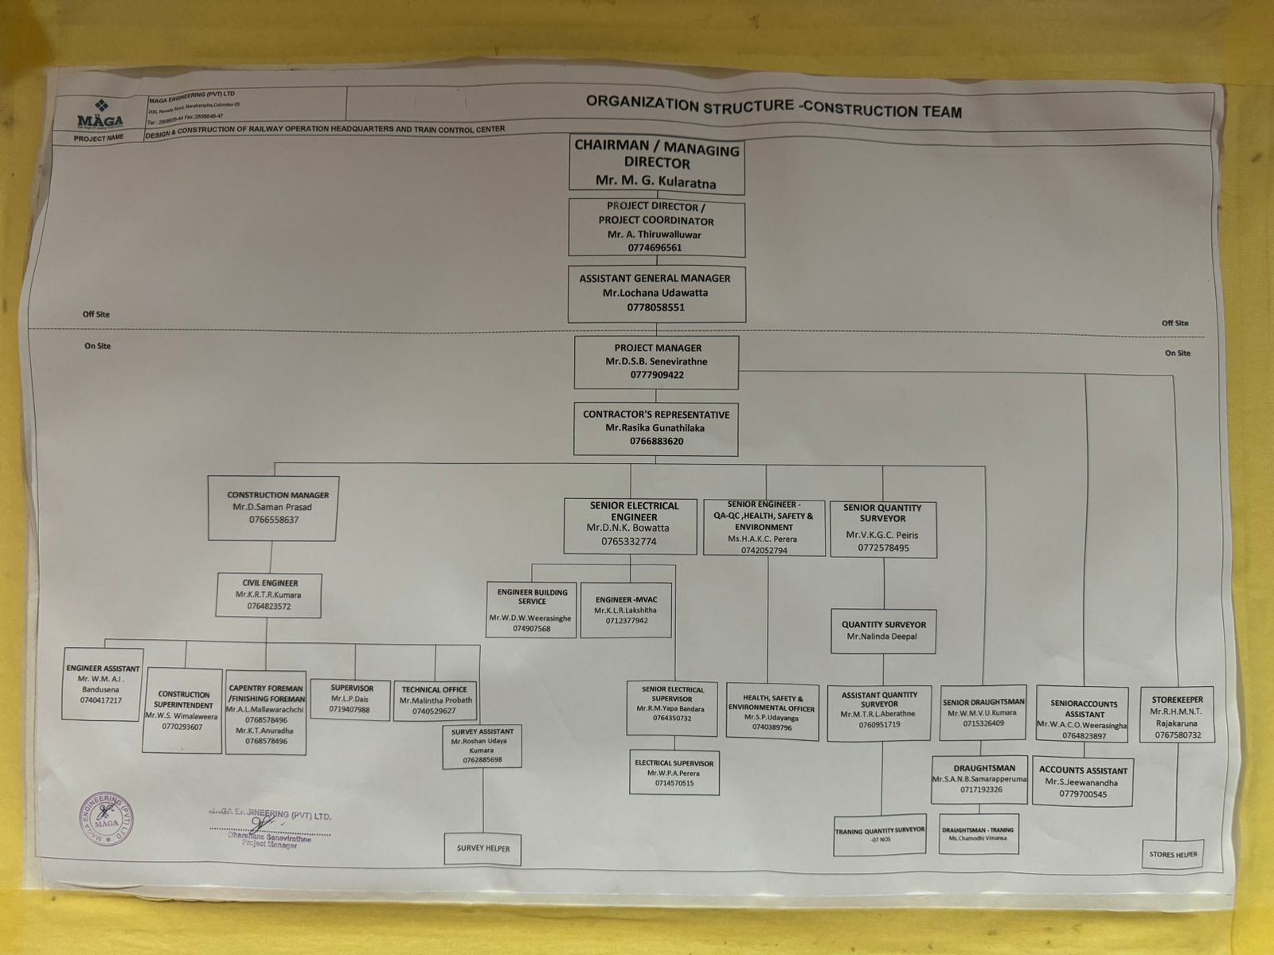
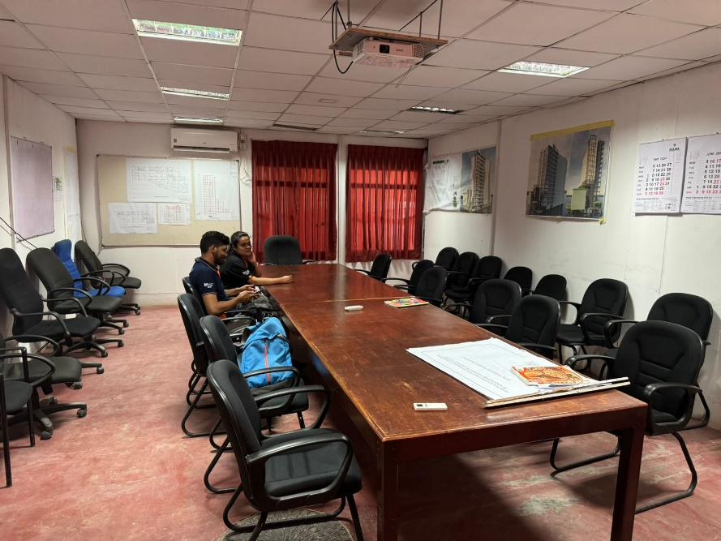
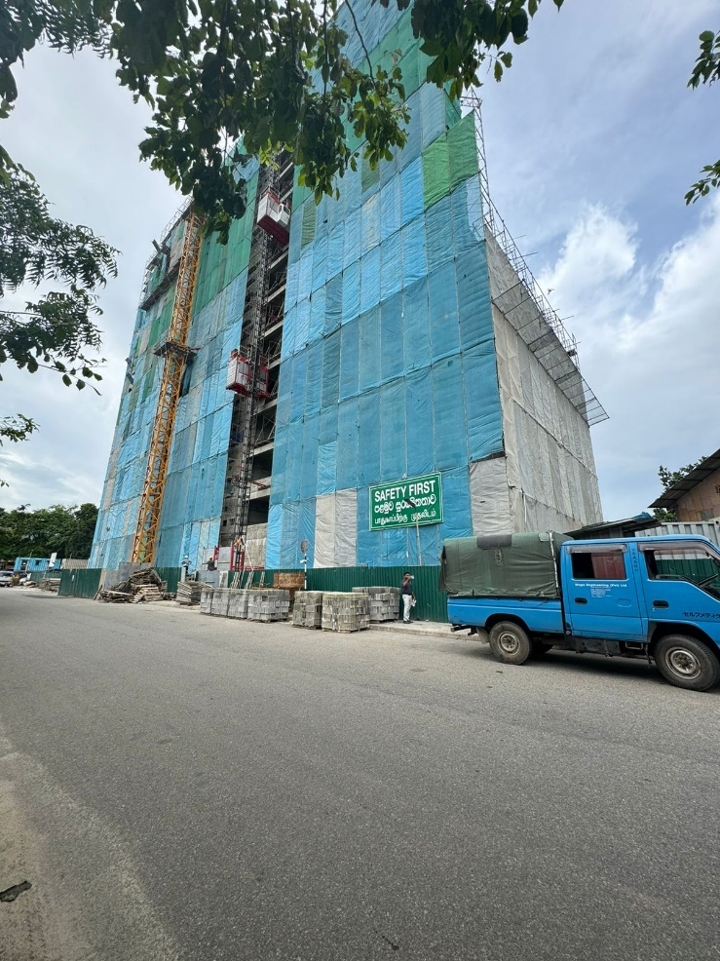
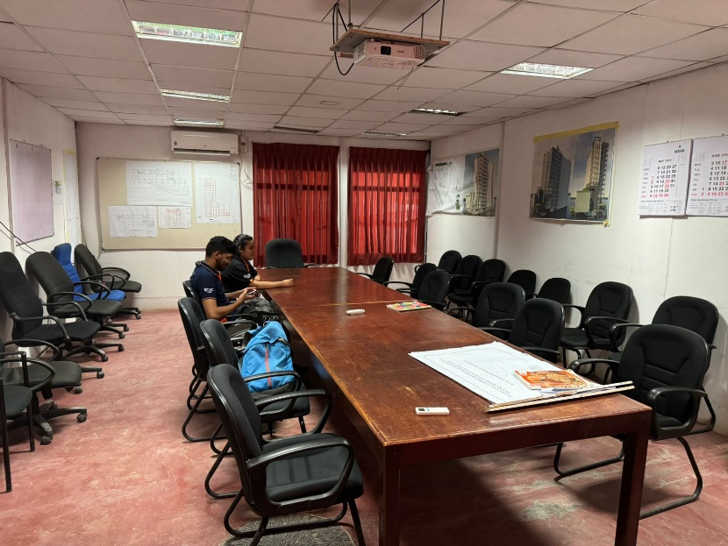
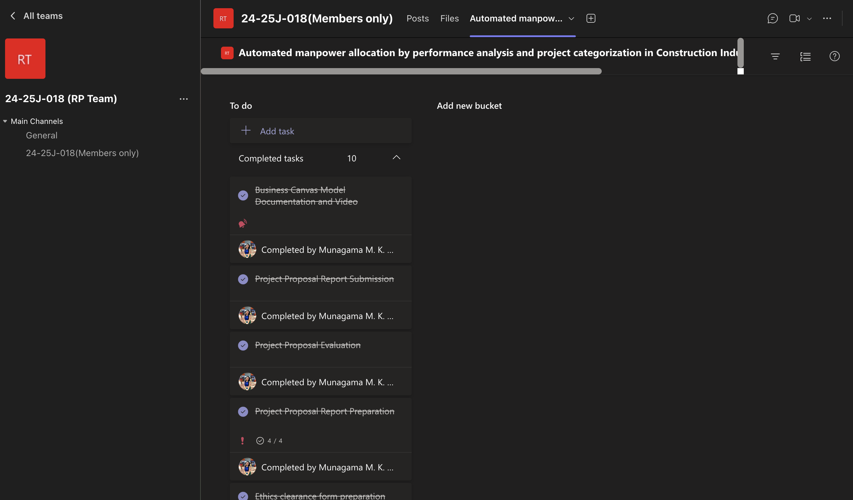
Evidences

Slide 5

Introduction
Manpower required in construction projects are in 2 types;
Employees in the Company
Ex: Civil Engineers,Technical Officers,Surveyors etc.
2. Laborers work in the site
Ex:Carpentors,Masons,Painters etc.
Our client : MAGA Engineering PVT LTD
Types of construction projects in MAGA;
Buildings
Highways & Bridges
Water, wastewater
Irrigation

Slide 6

Research Problem
"How does improper manpower allocation based on project managers' experience affect efficiency and project outcomes in the construction projects?”

Slide 7

Main Objective
"Develop a system to generate employee KPIs based on experience and performance, categorize projects by complexity and risk, optimally allocate suitable employees, and predict the required number of laborers for future projects."

Slide 8
Sub Objectives
Project Categorization.
KPI Value generation by performance analysis and CV analysis.
Employee allocation and Optimization.
Prediction of labor, cost and timeline.

Slide 9



Research Gap
Real time predictive analysis of project
Applicable for construction Projects
KPI based manpower allocation
Labor requirement Prediction
Application
Reference
Web Application
Project Categorization
Procore
Primavera P6
nPlan
BuildTrend
Project Pulse

Slide 10


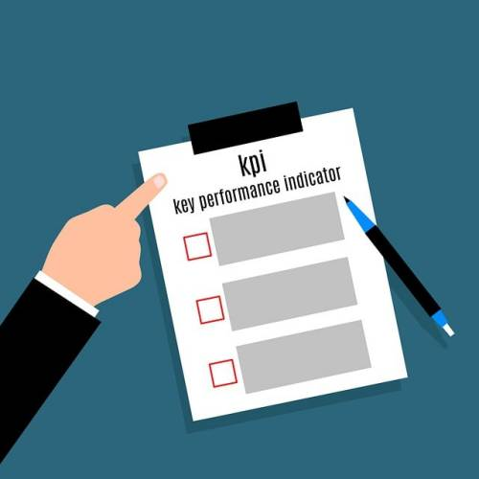












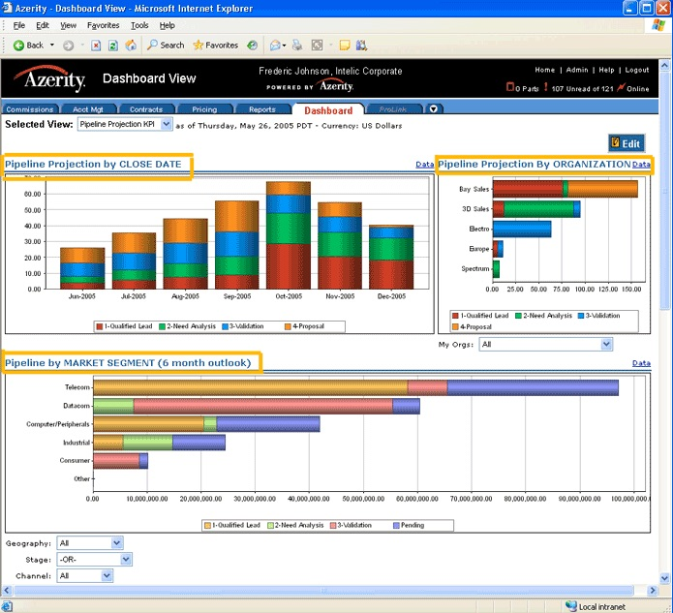

KPI Generation by CV detail analysis and Performance analysis
2
Storing CV details in the Database
Updating the KPI of employees according to the experience
1
Project Categorization
Employee CV Upload
Initial KPI Generation
Classifying Projects According to Criteria
Update KPI
Project Categorization
TimeFrame
Budget Level
Risk Level
Complexity
Geographical Factors
Environment Impact (Low,Medium,High)
Enters Upcoming Project Details
Projects Classification
KPI Value as a Percentage
HR Department
Allocated details of the employee
Project Manager
Labor,Cost and Timeline Prediction
Data Processing and Analysing
Labor Prediction on
Project Size and Completion days
Recording the Daily Tasks and Labor Attendance
Employee allocation and Optimization
Enters Daily Attendance and Tasks
3
Matching the KPI with Project Complexity
Predicting Cost and Timeline
4
Suggestions of the employees in order to select as per the requirement
Dashboard

Slide 11

IT21087660|Perera K.M
BSc(Hons)in Information Technology specialized in Information Systems Engineering
Project Categorization.
IT21067660 | Perera K.M | 24-25J-018

Slide 12

Research Question
How can construction projects be categorized by risk and complexity based on factors like project type, scope, objectives, location, budget, duration, size, and site conditions?
IT21067660 | Perera K.M | 24-25J-018

Slide 13

Specific & Sub Objectives
Gathering project details
Create a standardized method to categorize project mainly based on risk and complexity based on project details
Identify the project types
Define a specific criterion for categorizing the project
Predict the risk and complexity of the project
IT21067660 | Perera K.M | 24-25J-018

Slide 14



Research Gap
Application
Reference
Applicable for construction projects
Location/Environmental Impact Assessment
Budget Analysis
Time Frame Analysis
Automatic Classification
Risk Level Assessment
Complexity Analysis
Procore
Microsoft Project
Smartsheet
nPlan
Trello
Project Pulse
IT21067660 | Perera K.M | 24-25J-018

Slide 15

Methodology
Overview Diagram
Technologies
Data Gathering and Data Requirements
Current Progress
Project Evidence
Future Progress
IT21067660 | Perera K.M | 24-25J-018

Slide 16


Overview Diagram
Project Manager
Classifying Projects According to Criteria
Project Categorization
Risk Level
Complexity Fa (Low,Medium,High)
Enters Upcoming Project Details
Project Type
Scope
Objectives
Location
Budget
Duration
Site Conditions
Projects Classification
IT21067660 | Perera K.M | 24-25J-018

Slide 17



Technologies
Tools
Google Colab Notebook
VS Code
Technologies
Python V 3.10
React Js
Node Js
MYSQL
Techniques & Algorithms
Decision Tree Regressor Model
IT21067660 | Perera K.M | 24-25J-018

Slide 18

Data Gathering and Data Requirements
Data Source : MAGA Engineering Pvt Ltd.
Required datasets are;
Past Project Details
Time,Cost,Scope,Geographical Location, Objectives, Project Type
Risk and Complexity measuring methods
IT21067660 | Perera K.M | 24-25J-018

Slide 19
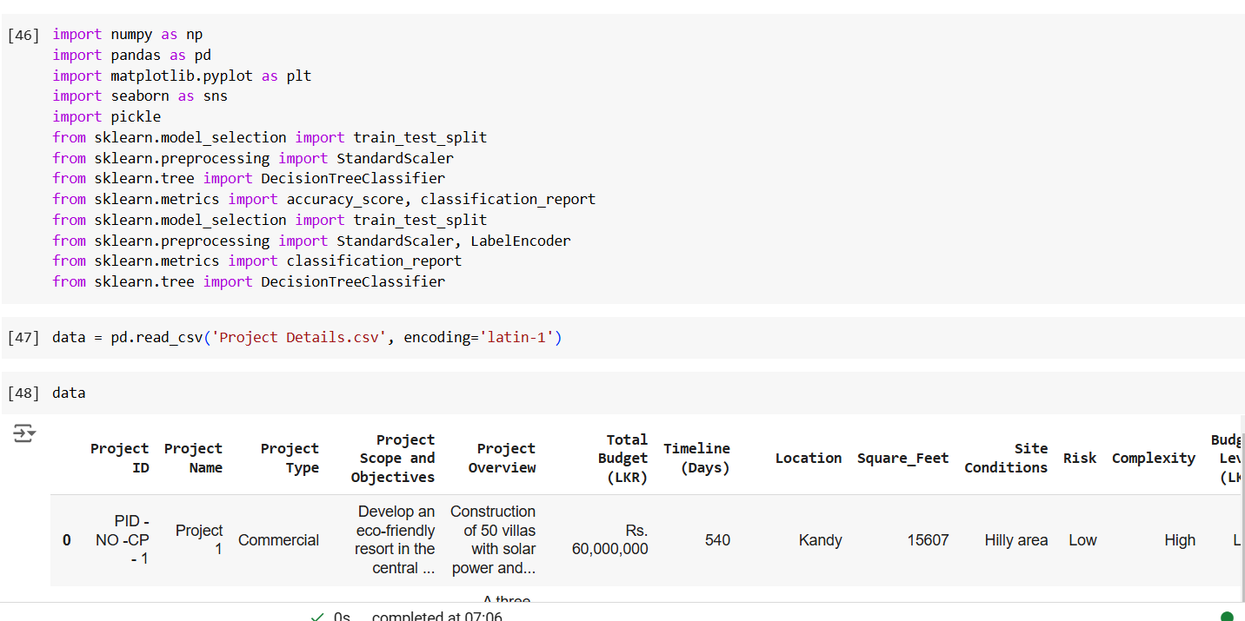
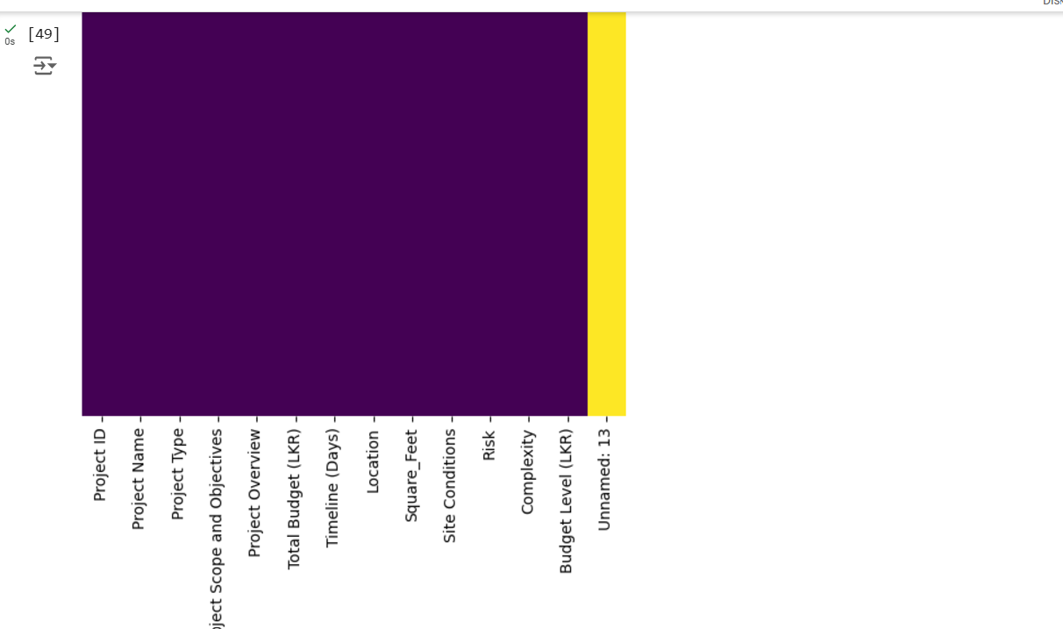
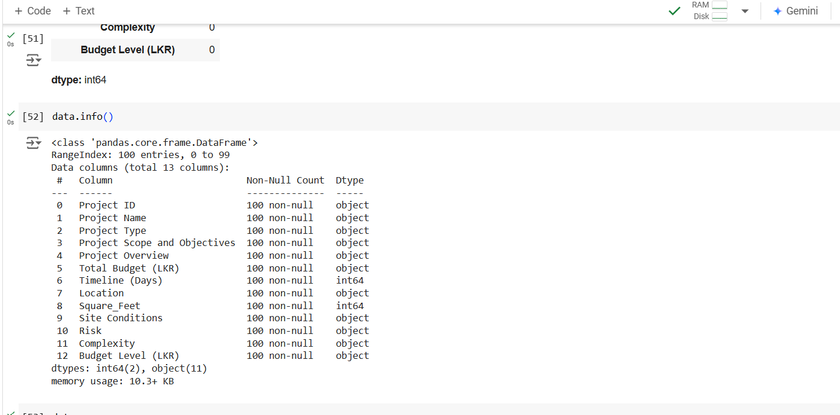
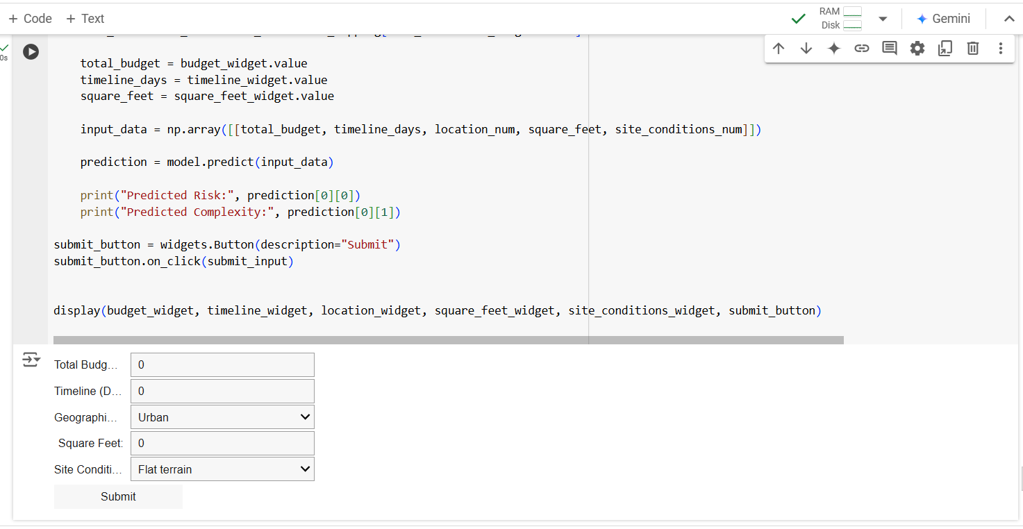
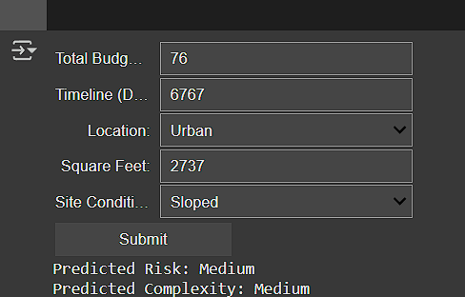
Project Evidence
IT21067660 | Perera K.M | 24-25J-018

Slide 20
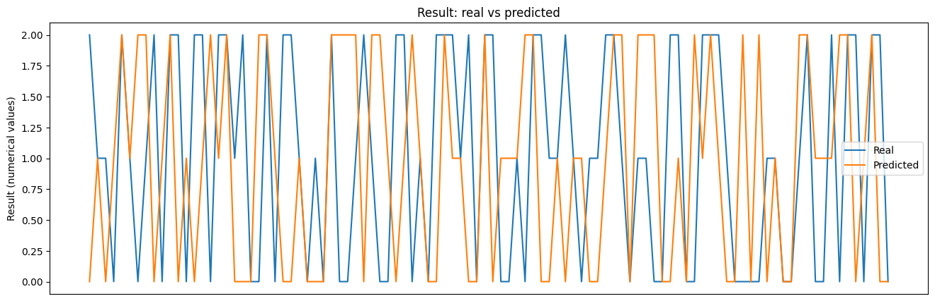
Project Evidence
Decision Tree (Both Risk and Complexity)
IT21067660 | Perera K.M | 24-25J-018

Slide 21
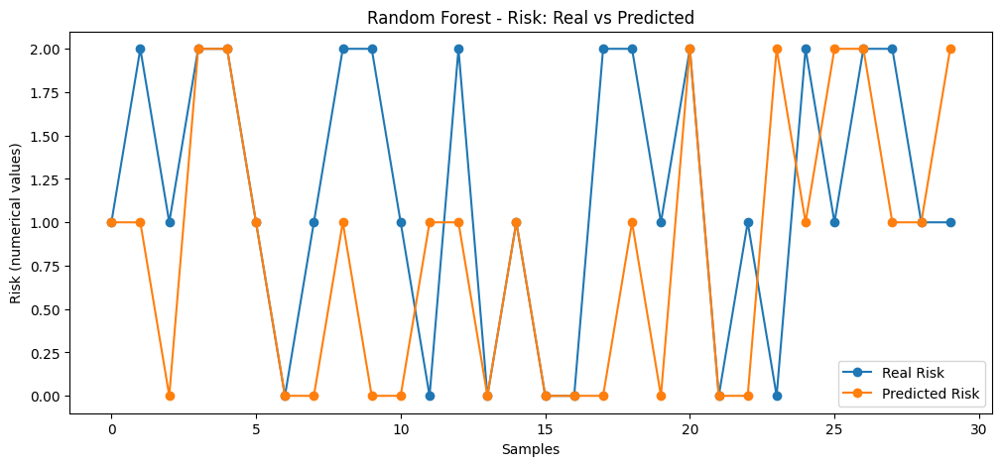
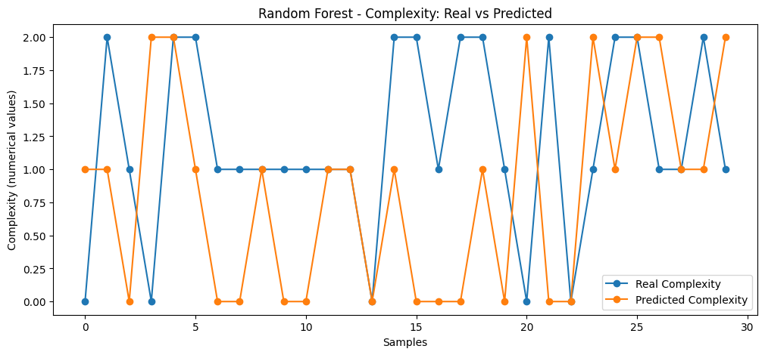
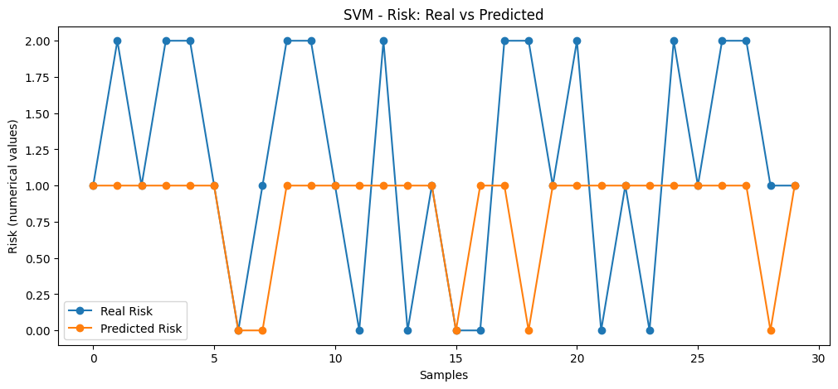
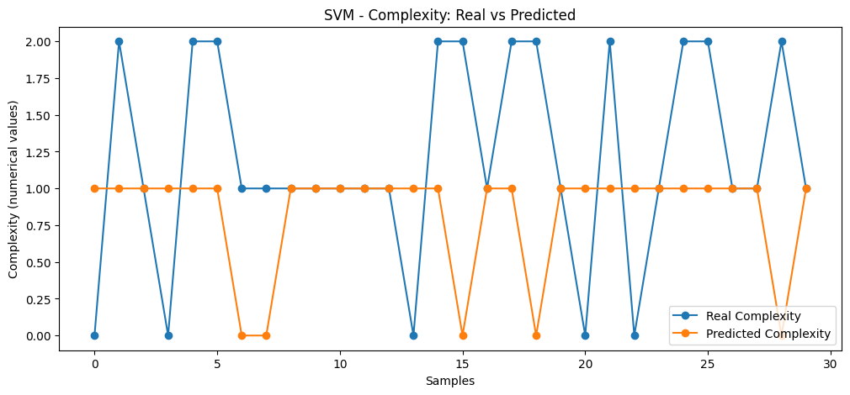
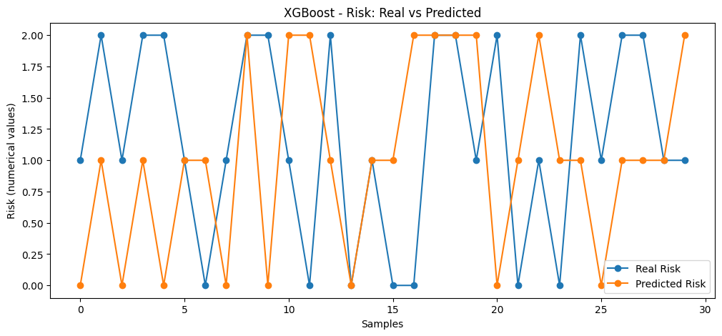
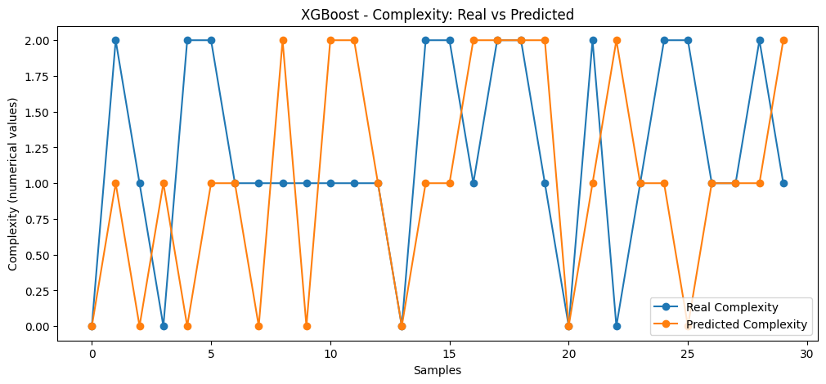
Project Evidence
Random Forest
SVM
XGBoost

Slide 22
REFERENCES
[1] John Macealois, “Understanding the 7 Construction Project Types”, https://www.workyard.com/construction-management/construction-project-types, May 2024 (accessed July. 2024) pp. 11,14.
[2] M. Safa, A. Sabet, “Classification of Construction Projects”, https://core.ac.uk/download/pdf/144150314.pdf , May 2015 (accessed July. 2024) pp. 11,14.
IT21067660 | Perera K.M | 24-25J-018

Slide 23

IT21276750|Isuranga K.M.S
BSc(Hons)in Information Technology specialized in Information Systems Engineering
KPI Generation by Performance analysis and CV analysis.
IT21276750 | Isuranga K.M.S | 24-25J-018

Slide 24

Research Question
“How can the challenges of managing physical CVs and using outdated KPIs be addressed to improve decision-making in employee management?”
IT21276750 | Isuranga K.M.S | 24-25J-018

Slide 25

Sub Objectives
Specific Objective
Developing a upload portal to upload CVs.
Developing a portal to update employees’ project work.
“ The goal is to generate accurate KPIs based on predefined criteria (Performance, Competencies, Additional Criteria) and provide
real-time KPI results for better decision-making. ”
Developing to calculate KPI percentage for generated KPI and given project details.
IT21276750 | Isuranga K.M.S | 24-25J-018

Slide 26
Research Gap
Real Time Integration with performance
Applicable for construction projects
Application
Reference
Performance Update
CV
Upload
KPI
Generation
SAP Success Factor
Workday
BambooHR
Procore
Project Pulse
IT21276750 | Isuranga K.M.S | 24-25J-018

Slide 27
Methodology
Overview Diagram
Technologies
Data Gathering and Data Requirements
Current Progress
Project Evidence
Future Progress
IT21276750 | Isuranga K.M.S | 24-25J-018

Slide 28


HR Department
Updating the KPI of employees according to the experience
Update existing KPI
Allocated details of the employee
KPI Value as a Percentage
Employee CV
Initial KPI Generation
Storing CV details in the Database
IT21276750 | Isuranga K.M.S | 24-25J-018

Slide 29
Technologies
Tools
Google Colab Notebook
VS Code
Technologies
Python V 3.10
React Js
Node Js
MYSQL
Techniques & Algorithms
Natural Language Processing
Multi Nominal NB Algorithm
IT21276750 | Isuranga K.M.S | 24-25J-018

Slide 30
Data Gathering and Data Requirements
Main Data Source : MAGA Pvt Ltd.
Required datasets are;
KPI definning criteria
Performance – 60%
Competencies (Knowledge,Skills) -20%
Additional Criteria (Seniority and years of service) -20%
Employee CV details of each employee category
IT21276750 | Isuranga K.M.S | 24-25J-018

Slide 31
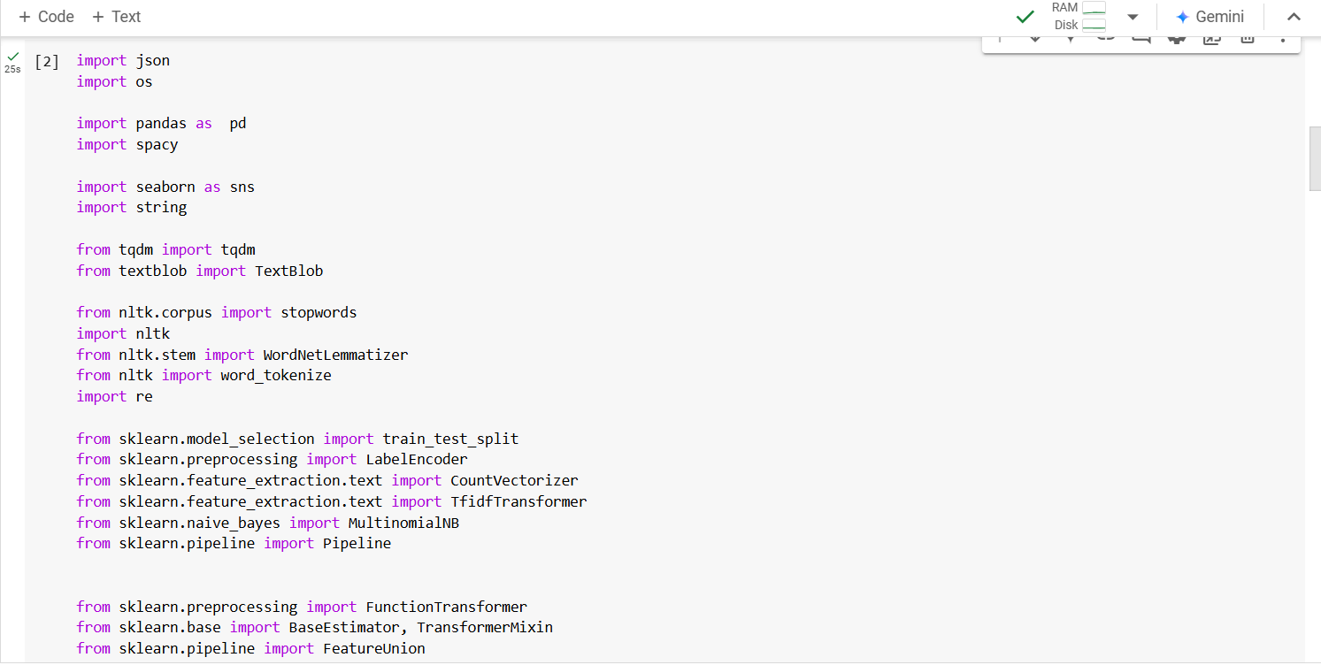
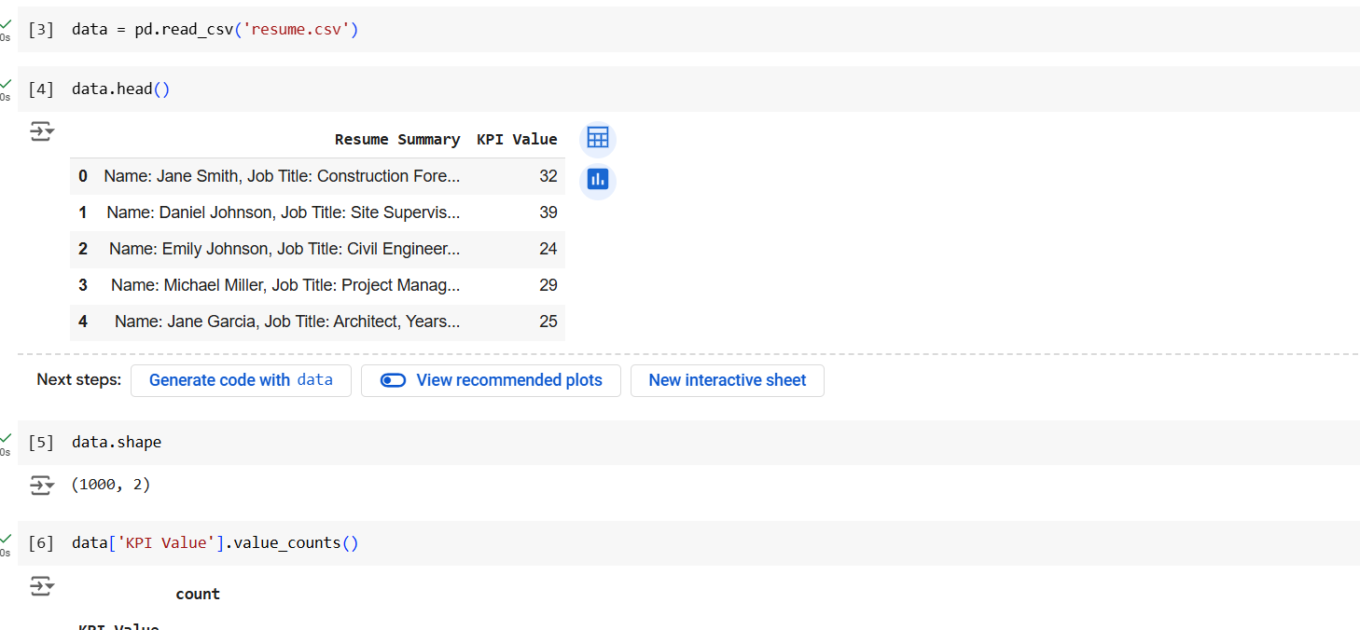
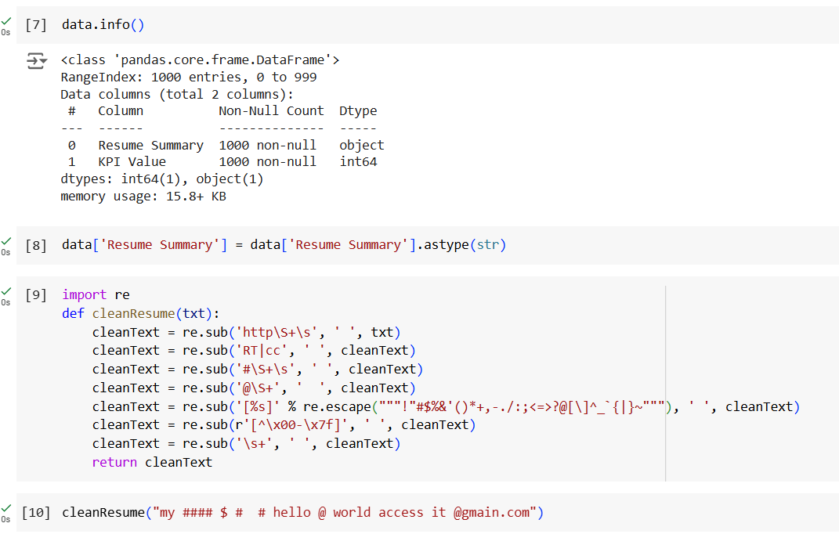
Project Evidence (PP1)
IT21276750 | Isuranga K.M.S | 24-25J-018

Slide 32
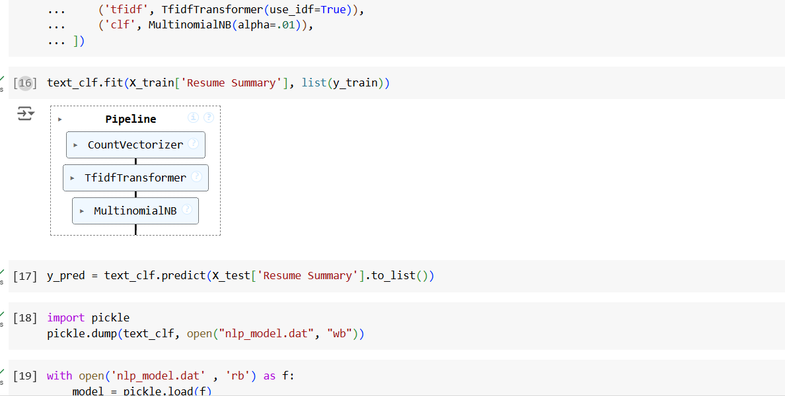
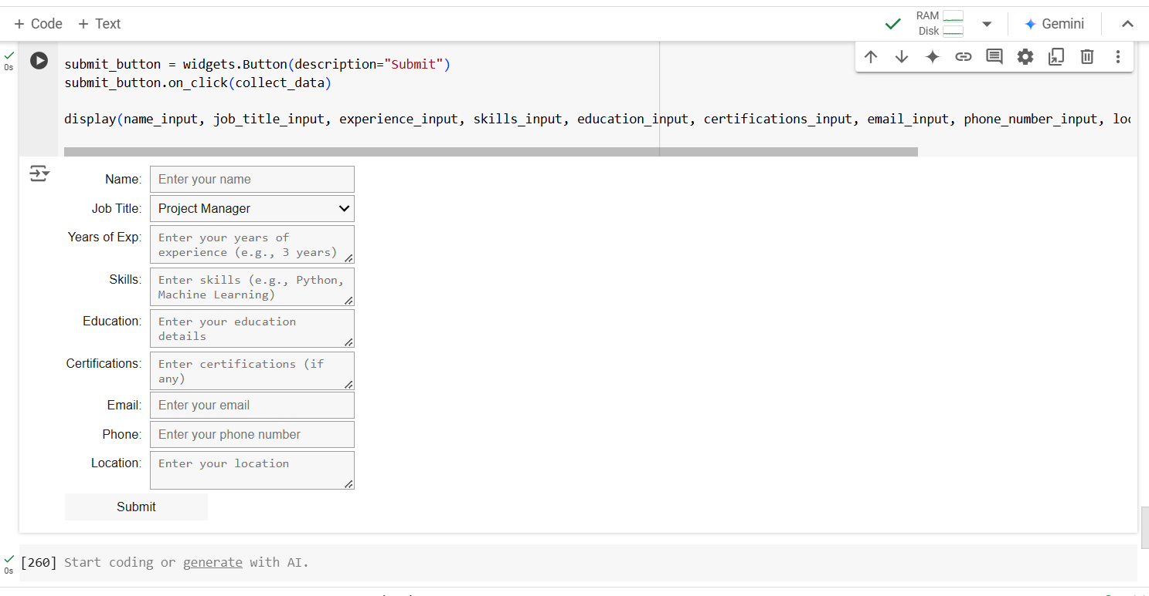
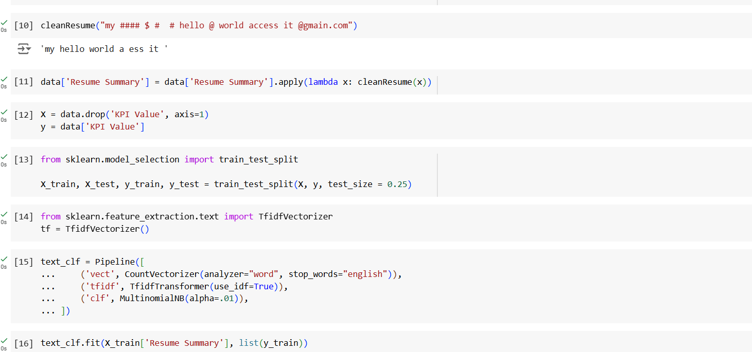
Project Evidence (PP1)

Slide 33
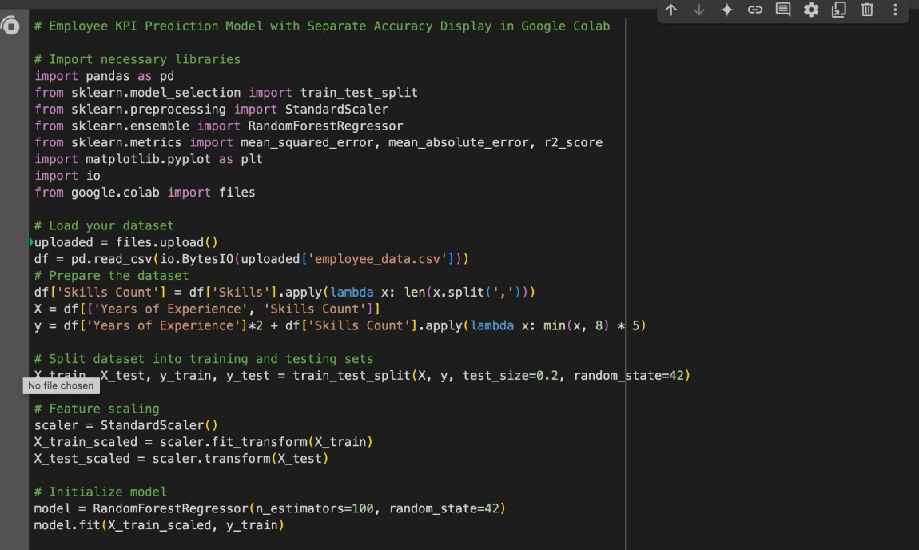
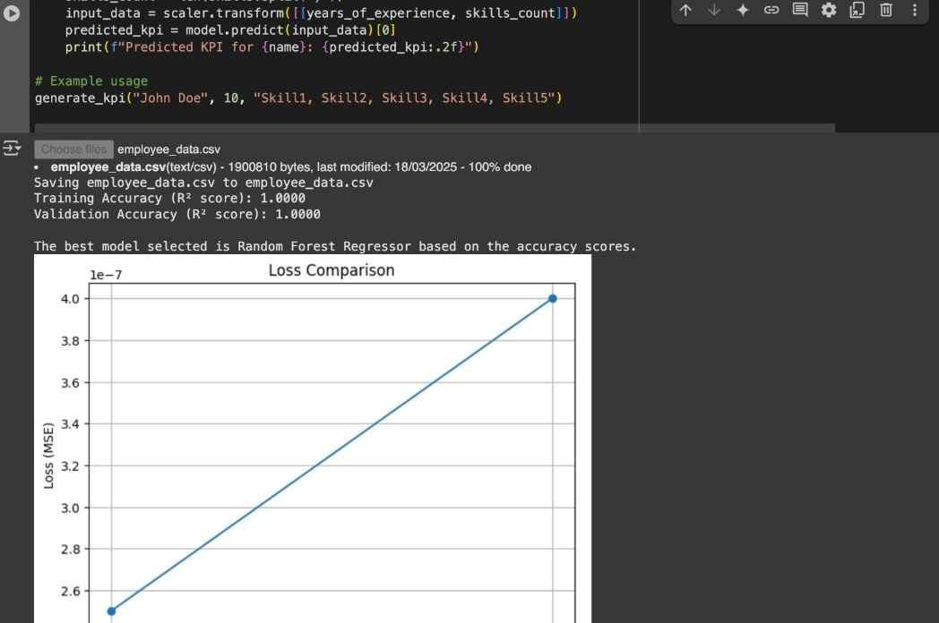
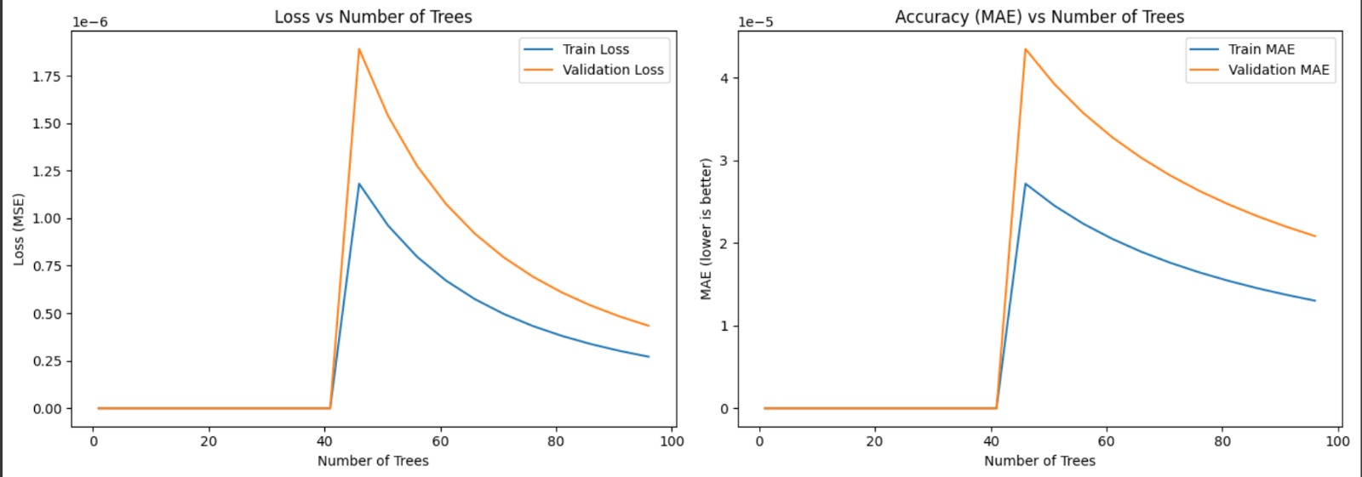
Decision Tree Regression
Accuracy Score : 0.75
Trained Models
Random Forest Regression
Accuracy Score:1

Slide 34
REFERENCES
[1] A. Anand, "Ijiraset," [Online]. Available: https://www.ijraset.com/research-paper/cv-analysis-using-machine-learning. [Accessed 25 07 2024].
[2] V. Jagwani, "Arvix," [Online]. Available: https://arxiv.org/pdf/2307.15752. [Accessed 25 07 2024].
[3] H. A. Purba, "Research Gate," [Online]. Available: https://www.researchgate.net/publication/344493860_KEY_PERFORMANCE_INDICATORS_A_SYSTEMATIC_LITERATURE_REVIEW. [Accessed 26 07 2024].
[4] L. Pinilla, "MDPI," [Online]. Available: https://www.mdpi.com/2071-1050/12/15/5977. [Accessed 27 07 2024].
[5] MAGA, "MAGA," [Online]. Available: https://www.maga.lk/. [Accessed 24 07 2024].
IT21276750 | Isuranga K.M.S | 24-25J-018

Slide 35
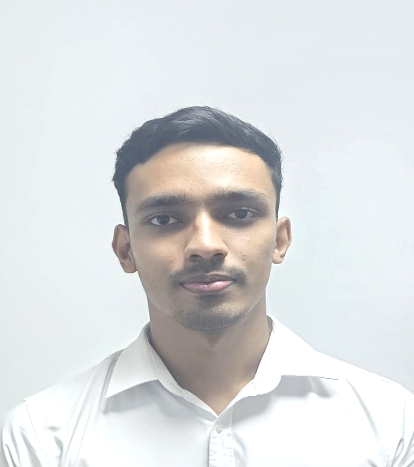
IT21069840|Devashika R.P.P.A
BSc(Hons)in Information Technology specialized in Information Systems Engineering
Employee Allocation and Optimization.
IT21069840 | Devashika R.P.P.A | 24-25J-018

Slide 36

Research Question
“How can employee allocation by project managers, which is often based on experience, be improved to reduce inefficiencies and address employee management issues? "
IT21069840 | Devashika R.P.P.A | 24-25J-018

Slide 37
Gather outcomes of component 1 and 2
such as project categorization result and generated KPI.
Specific Objective
Develop a model for matching employees to
projects using the identified KPIs.
“Develop a systematic approach for allocating employees to categorized construction projects using Key Performance Indicators (KPIs) to improve project efficiency and outcomes.”
Optimize the outcome of this component
Validate the model with historical data and
real-world scenarios.
IT21069840 | Devashika R.P.P.A | 24-25J-018

Slide 38
Research Gap
Applicable for construction projects
KPI-based manpower allocation
Employee requirement prediction
Employee allocation and optimization
Application
Reference
Web Application
Procore
Primavera P6
BuildTrend
ALICE Technologies
PlanGrid
Project Pulse
IT21069840 | Devashika R.P.P.A. | 24-25J-018

Slide 39
Methodology
Overview Diagram
Technologies
Data Gathering and Data Requirements
Current Progress
Project Evidence
Future Progress
IT21069840 | Devashika R.P.P.A | 24-25J-018

Slide 40
Overview Diagram
Project Categorization
TimeFrame
Budget Level
Risk Level
Complexity
Geographical Factors
Environment Impact (Low,Medium,High)
KPI Value as a Percentage
Project Manager
Matching the KPI with Project Categorization Results
Suggestions of the employee IDs in order to select as per the requirement
IT21069840 | Devashika R.P.P.A | 24-25J-018

Slide 41
Technologies
Tools
Google Colab Notebook
VS Code
Technologies
Python V 3.10
React Js
Node Js
MYSQL
Techniques & Algorithms
Decision Tree Regressor Model
IT21069840 | Devashika R.P.P.A | 24-25J-018

Slide 42

Data Gathering and Data Requirements
Main Data Source : MAGA Pvt Ltd.
Required datasets are;
Number of employees worked in certain projects.
Employee categories required for different projects.
IT21069840 | Devashika R.P.P.A | 24-25J-018

Slide 43
Current Progress
Data gathering to create a datset.
Cleaning the collected data set.
Trained a dataset to generate the KPI values according to the performances and experiences.
IT21069840 | Devashika R.P.P.A | 24-25J-018

Slide 44
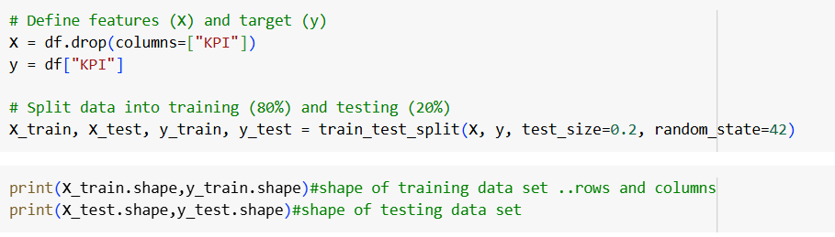
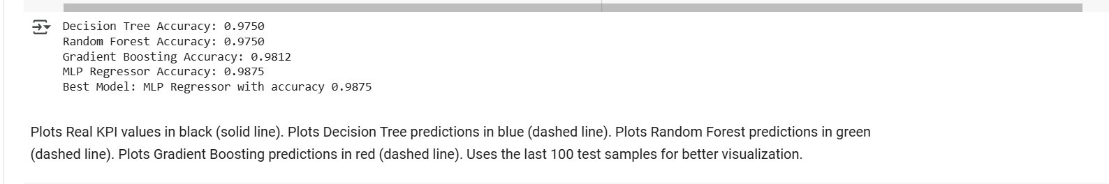
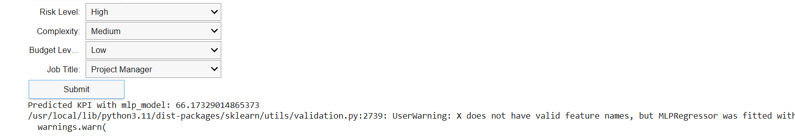
Project Evidence
IT21069840 | Devashika R.P.P.A | 24-25J-018

Slide 45
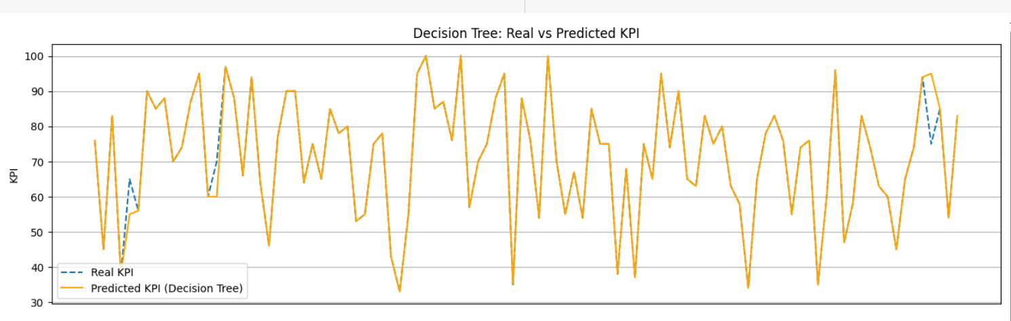
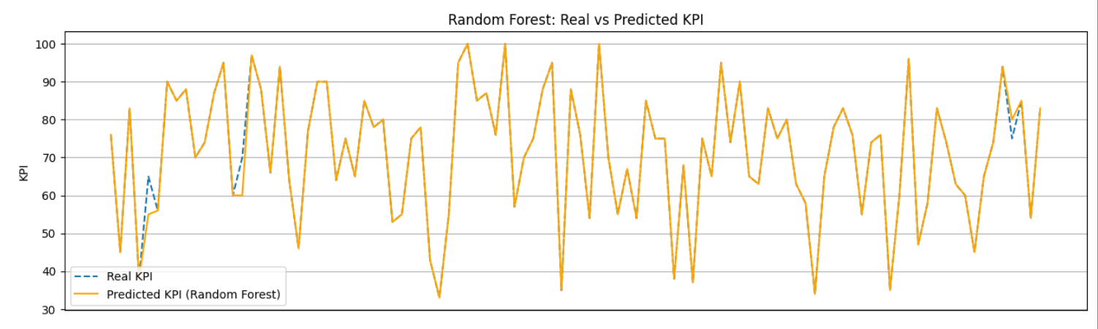
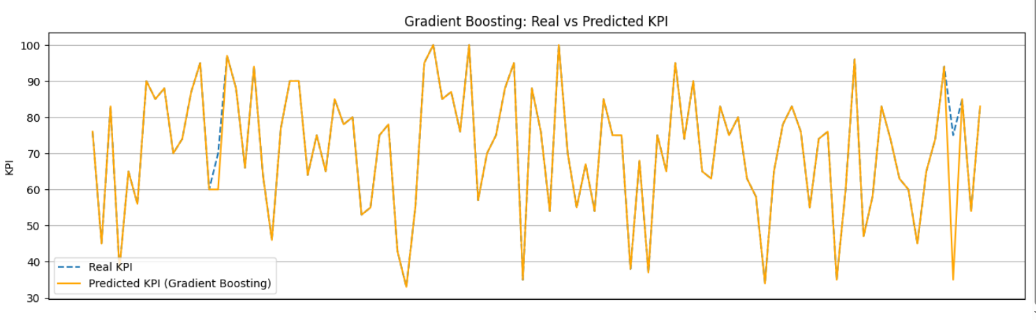
Project Evidence
IT21069840 | Devashika R.P.P.A | 24-25J-018

Slide 46
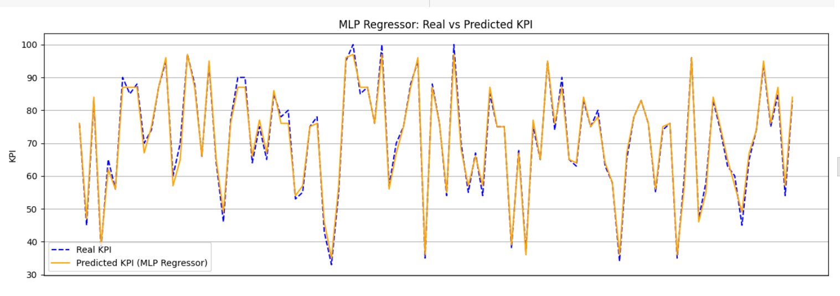
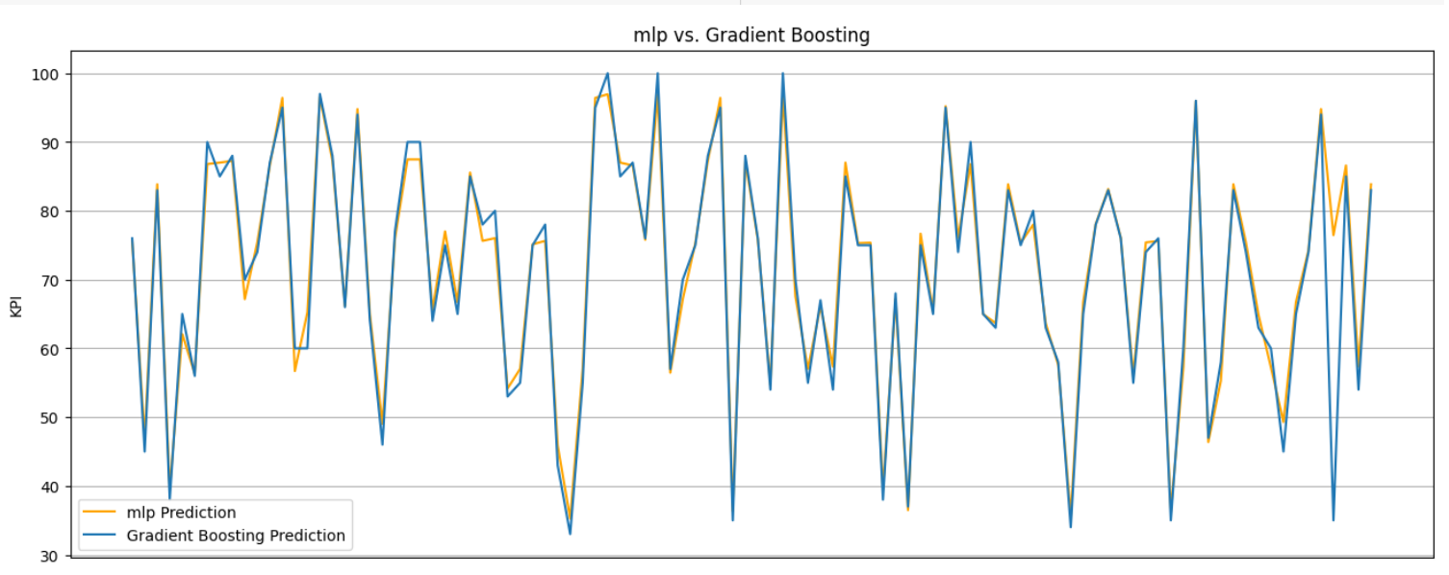
Project Evidence
IT21069840 | Devashika R.P.P.A | 24-25J-018

Slide 47
Future Progress
Frontend Implementation
Component Integration
Increasing dataset size to improve the accuracy
IT21069840 | Devashika R.P.P.A | 24-25J-018

Slide 48
REFERENCES
[1] | TaskTag, "MEDIUM," [Online]. Available: https://tasktagapp.medium.com/resource-allocation-in-construction-strategies-for-optimal-performance-e05bf5270b00. [Accessed 31 07 2024].
[2] | K.-L. Lin, "researchgate," [Online]. Available: https://www.researchgate.net/publication/245298399_Human_Resource_Allocation_for_Remote_Construction_Projects. [Accessed 31 07 2024].
[3] | "MAGA," [Online]. Available: https://www.maga.lk/. [Accessed 15 6 2024].
[4] | J. Amin and Hafnidar A. Rani, "researchgate," [Online]. Available: https://www.researchgate.net/publication/380537686_Optimizing_Human_Resource_Allocation_in_Construction_Projects_A_Case_Study. [Accessed 3 7 2024].
IT21069840 | Devashika R.P.P.A | 24-25J-018

Slide 49
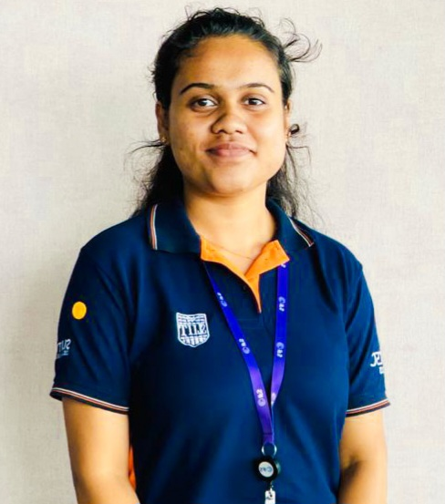
IT21270956|Munagama m.k.h
BSc(Hons)in Information Technology specialized in Information Systems Engineering
Labor, cost and timeline prediction.
IT21270956 | Munagama M.K.H | 24-25J-018

Slide 50

Research Question
“How can the inefficiencies in labor allocation, irregular attendance affects the cost and timeline in construction projects?”
IT21270956 | Munagama M.K.H | 24-25J-018

Slide 51
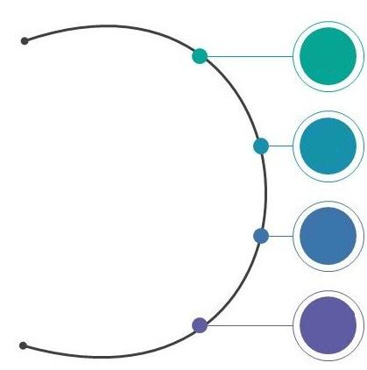
Sub Objectives
Analyzing past project details.
Specific Objective
1
Training the system according to the past project details.
To predict the labor count required for upcoming projects based on project categorization and to forecast the project timeline and cost during its progression.
2
Creating a platform to update the daily labor count and completed tasks.
3
Predicting the realtime status of the projects.
4
IT21270956 | Munagama M.K.H | 24-25J-018

Slide 52
Research Gap
Predict timeline and budget variations
Applicable for construction projects
Labor requirement prediction
Tracking daily logs and attendance
Application
Reference
User Focused
Dashboards
Procore
ALICE Technologies
nPlan
LaborChart
PlanGrid
Project Pulse
IT21270956 | Munagama M.K.H | 24-25J-018

Slide 53
Methodology
Overview Diagram
Technologies
Data Gathering and Data Requirements
Current Progress
Project Evidence
Future Progress
IT21270956 | Munagama M.K.H | 24-25J-018

Slide 54
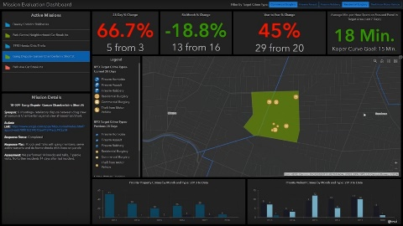
Overview Diagram
Project Manager
Recording the Daily Tasks and Labor Attendance
Enters Daily Attendance and Tasks
Predicting Cost and Timeline
Dashboard
Labor Prediction on Project Categorization
Project Categorization
TimeFrame
Project Size
IT21270956 | Munagama M.K.H | 24-25J-018

Slide 55
Technologies
Tools
Google Colab Notebook
VS Code
Technologies
Python V 3.10
React Js
Node Js
MYSQL
Power Bi
Techniques & Algorithms
Decision Tree Regressor Model
IT21270956 | Munagama M.K.H | 24-25J-018

Slide 56

Data Gathering and Data Requirements
Main Data Source : MAGA Pvt Ltd.
Required datasets are;
Budget ,Timeline and Number of labours worked at the past project.
Labor categories required for the projects.
Labor histogram details of each project.
IT21270956 | Munagama M.K.H | 24-25J-018

Slide 57
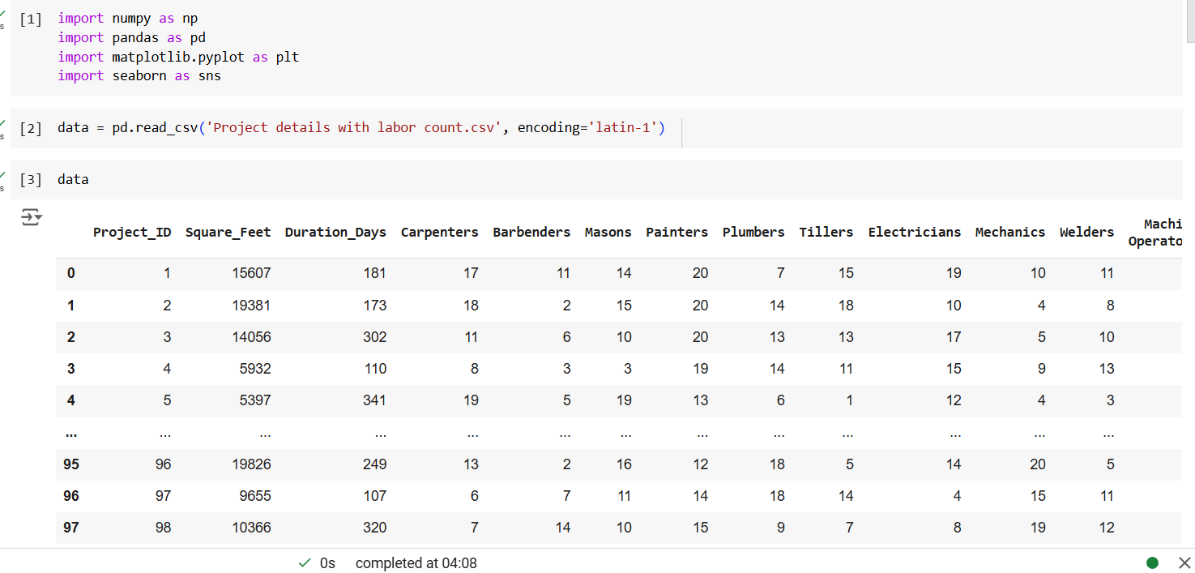
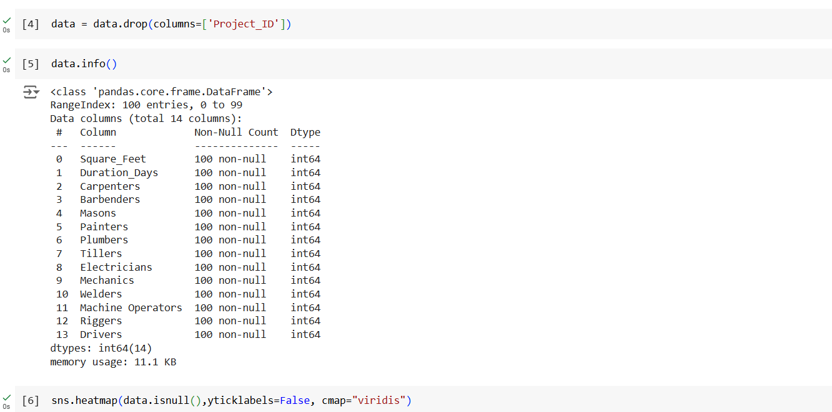
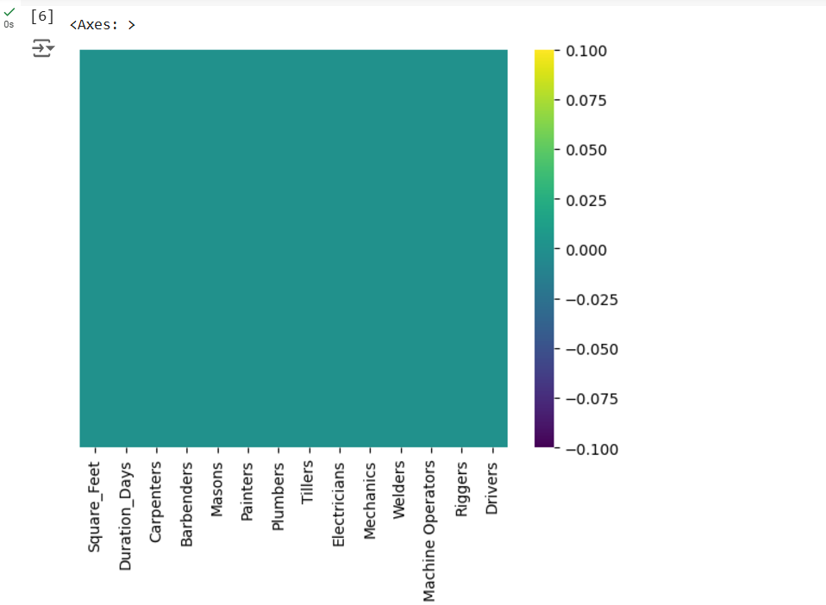
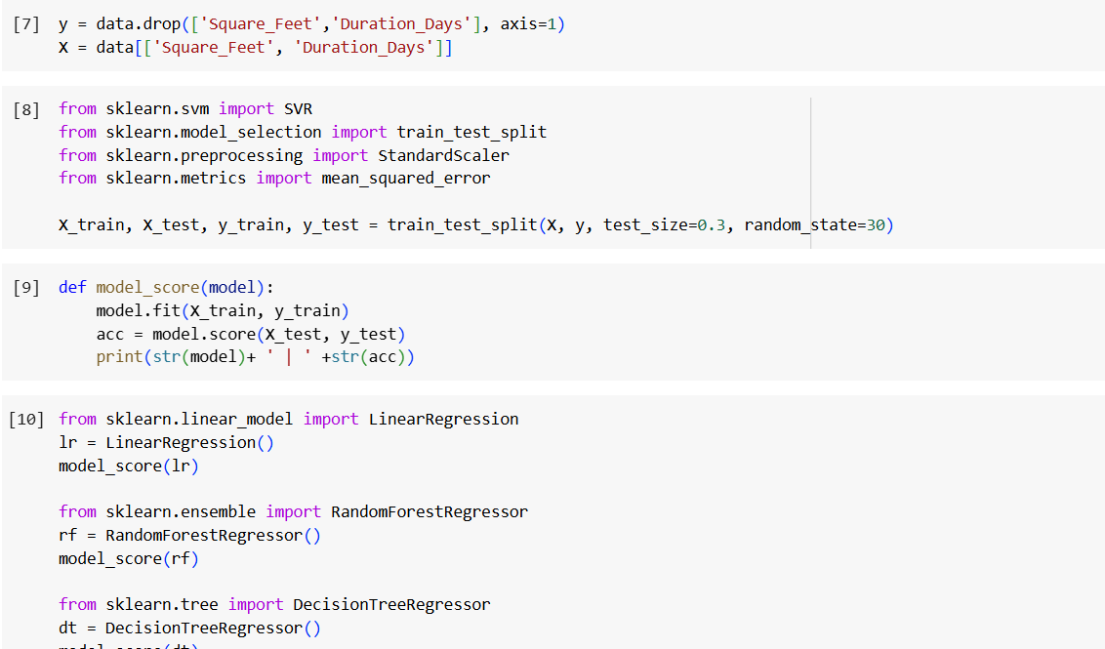
Project Evidence (PP1)
IT21270956 | Munagama M.K.H | 24-25J-018

Slide 58
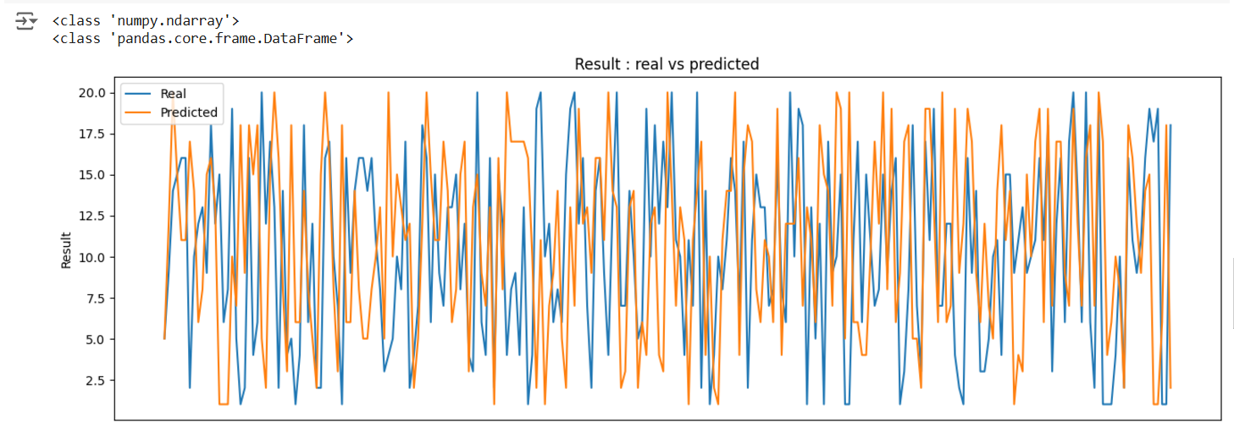
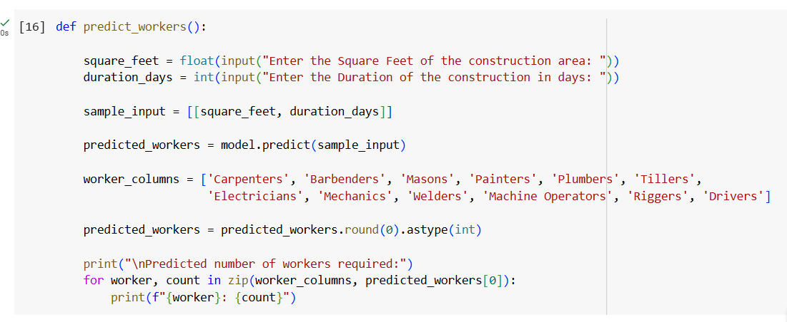
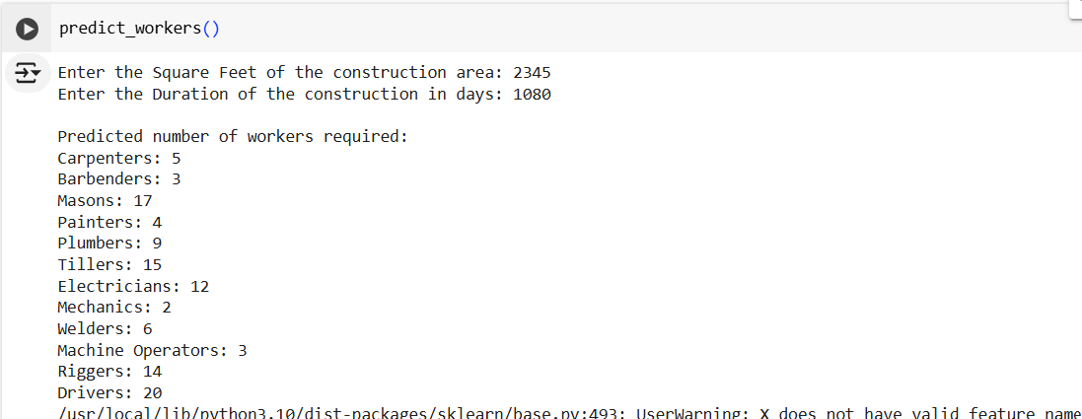
Project Evidence (PP1)
IT21270956 | Munagama M.K.H | 24-25J-018

Slide 59
Feedbacks from the PP1
Advised to consider the no of floors, no of windows and doors when predicting the labor count.
Used : TimeLine, Square Feets
Asked to select the most accurate model among few.
Used : Decision Tree Regression
Increase the dataset.

Slide 60
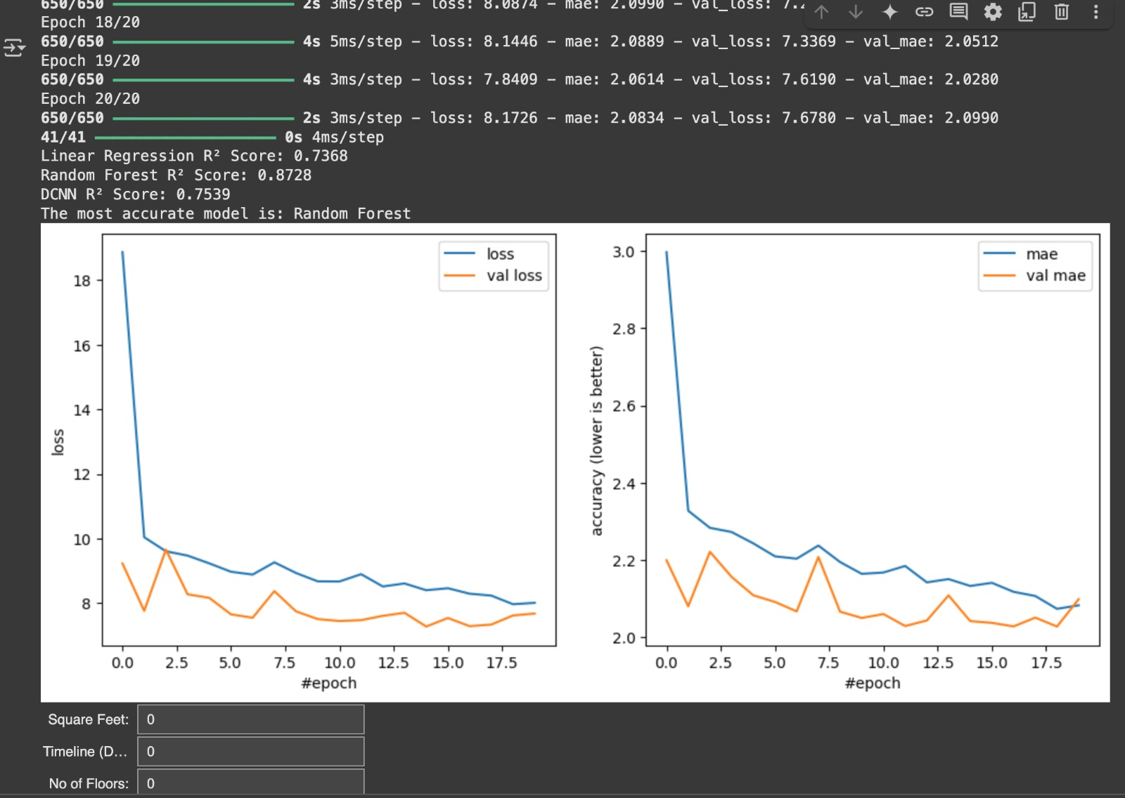
Trained Models
Deep Convolutional Neural Network
Accuracy Score : 0.7539
Linear Regression
Accuracy Score : 0.7368
Random Forest Regression
Accuracy Score : 0.8728
IT21270956 | Munagama M.K.H | 24-25J-018

Slide 61
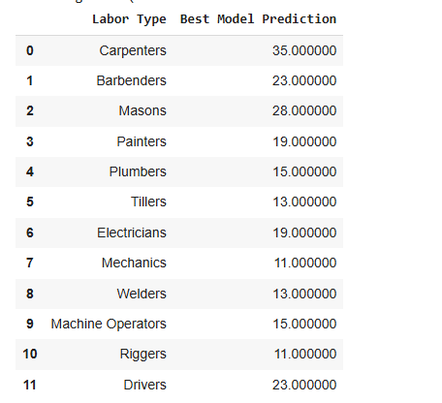
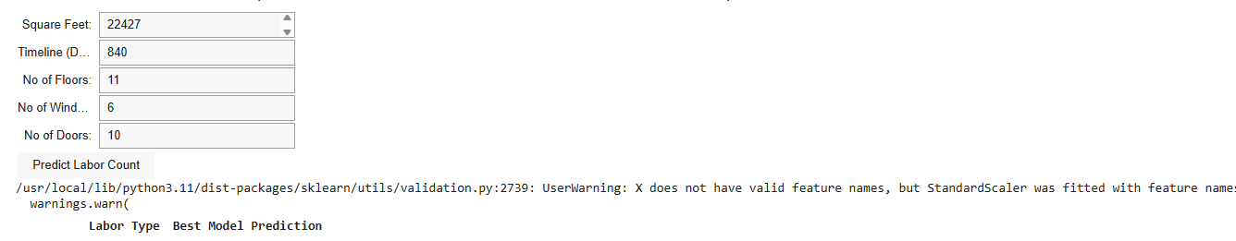

Slide 62
REFERENCES
[1] S. Direct, "Science Direct," [Online]. Available: https://wwwsciencedirect..com/science/article/pii/S2589933322001434. [Accessed 24 07 2024].
[2] Y. H. Yang, "Science Gate," [Online]. Available: https://www.sciencegate.app/app/document/download#10.28991/cej-2019-03091362. [Accessed 24 07 2024].
[3] A. Z. Zara Kahavandi, "Science Gate," [Online]. Available: https://www.sciencegate.app/app/document/download#10.28991/cej-2019-03091362. [Accessed 25 07 2024].
[4] S.-W. Whang, "Science Gate," [Online]. Available: https://www.sciencegate.app/app/document/download#10.28991/cej-2019-03091362. [Accessed 26 07 2024].
[5] Z. Smith, "Research Gate," [Online]. Available: https://www.researchgate.net/publication/382596196_COMPARATIVE_ANALYSIS_OF_BIG_DATA-DRIVEN_DECISION_MAKING_IN_PROJECT_MANAGEMENT. [Accessed 27 07 2024].
[6] M. Engineering, "MAGA," [Online]. Available: https://www.maga.lk/. [Accessed 24 07 2024].
IT21270956 | Munagama M.K.H | 24-25J-018

Slide 63
Demonstration

Slide 64

Q&A?

Slide 65

Thank You

